Slide 1
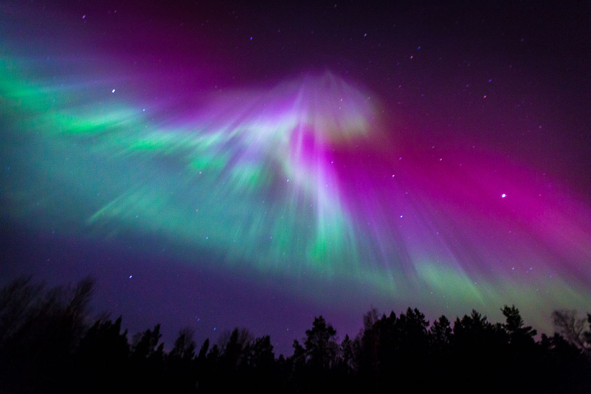


FLEIGER Fly Smarter, Fly Safer

Slide 2
Radioactive Doses From Radiation Sources
All doses from the National Council on Radiation Protection and Mesurments, Report no. 160
Cosmic radiation living at sea
Head CT
Whole body
CT scan
Radon in average US home
Cosmic radiation in Denver (high elevation)
Terrestial radioactivity
Near a nuclear power station
 | 1000 | 600 | 228 | 200 | 80 | 42 | 30 | 29 | 21 | 10 | 1
Radiation
in millirem
Mammogram
Chest x-ray
Upper Gastrointestinal x-ray with fluoroscopy
Radiation in the body

Slide 3
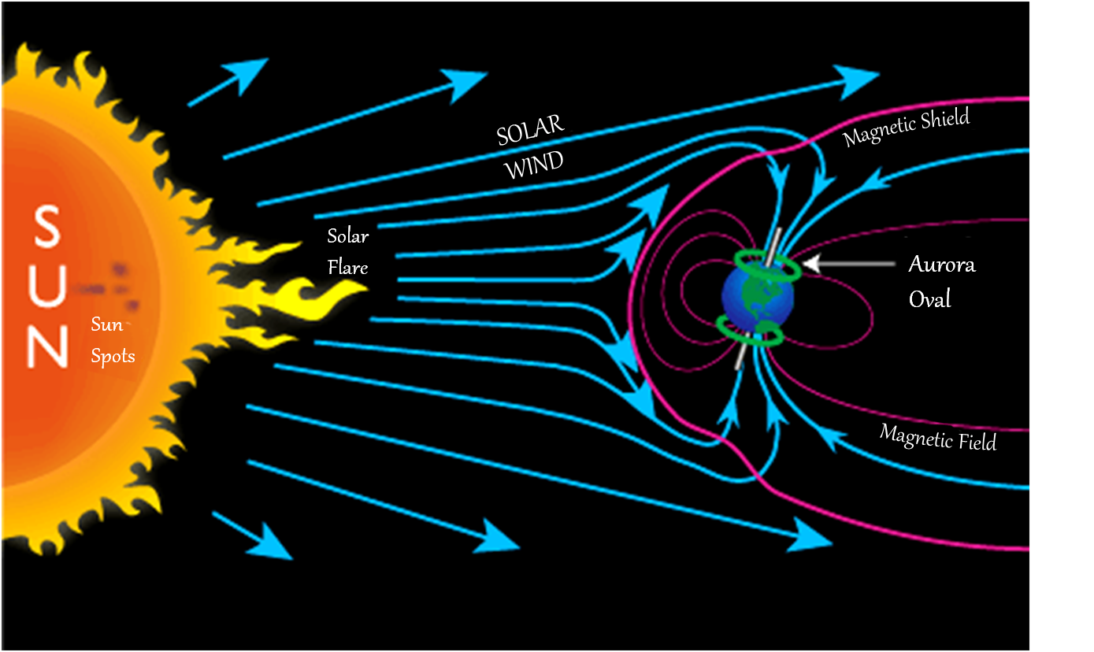
The Magnetosphere
Source: www.aurora-service.eu/aurora-school/aurora-borealis/

Slide 4
The Problem
Risk of radiations at higher altitudes during long distance and polar/near-polar flights
Excessive radiation exposure results in:
Radiation Sickness
Increased risk of genetic abnormalities in foetuses
Higher risk of cancer

Slide 5
Existing Tools
Online free radiation rate calculators:
Complicated parameters
Time based data not easily available
Contain Airport -> Airport data
EPCARD (German) , PCAire (Canadian), CARI (FAA):
Not user friendly
Terminal based
Target commercial airlines and not an average consumer

Slide 6
Why Fleiger?
One stop spot for aviation radiation exposure data.
Real time data modelling and updates.
Users prefer interactive interfaces for obtaining information.

Slide 7
`
Future opportunities
With the NAIRAS database we can:
Model Solar flares, Solar winds, etc.
Stream continuous information
Filter flight paths : Radiation as parameter
Flight rerouting and optimization : Radiation anomalies

Slide 8
`
Potential Business Model
Free App Release
Health Conscious Public
Awareness Development
Commercial Airlines
Customize Interface
Add features
Data
Anonymized consumer data available to public
Additional deliverable

Slide 9
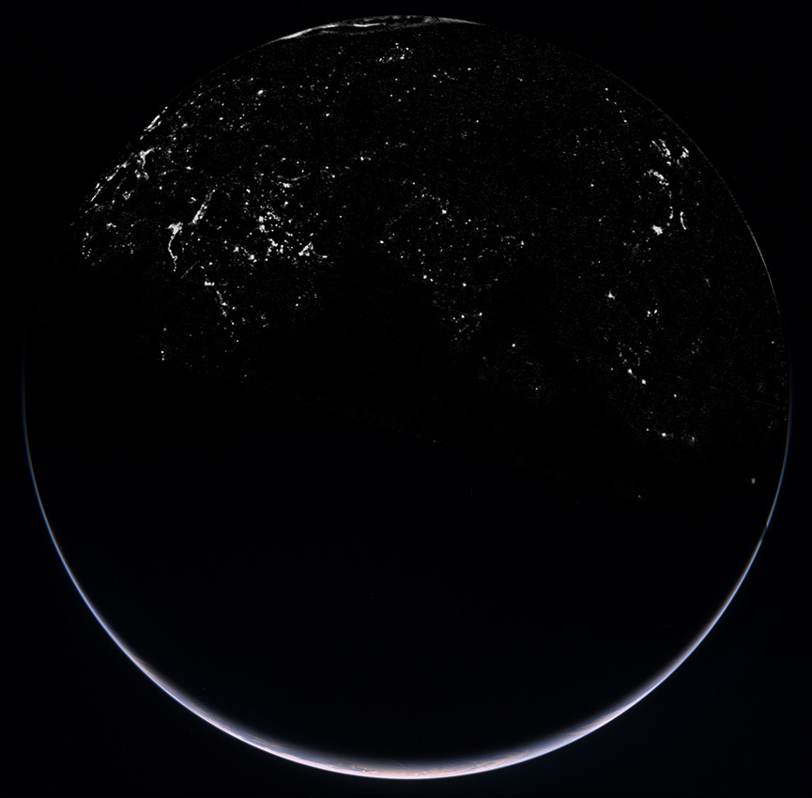
THANK YOU

